Slide 1
Sentiment analysis
Taixing Bi
Yailei Bi
Yuqing Ye

Slide 2
OUTLINE
Tool
Tokenziation
Word embedding
Cnn
Lstm
Metrics
reference

Slide 3
data
The labeled data set consists of 50,000 IMDB movie reviews, specially selected for sentiment analysis. The sentiment of reviews is binary, meaning the IMDB rating < 5 results in a sentiment score of 0, and rating >=7 have a sentiment score of 1. No individual movie has more than 30 reviews. The 25,000 review labeled training set does not include any of the same movies as the 25,000 review test set. In addition, there are another 50,000 IMDB reviews provided without any rating labels
https://www.kaggle.com/c/word2vec-nlp-tutorial/data

Slide 4
TOOL
Keras is an abstraction layer for Theano and TensorFlow.
Don’t have to deal with computing the input/output dimensions of the tensors between layers.

Slide 5
TOKENIZATION
Tokenizing sentence, remove stop words..
Encode word

Slide 6
Word embedding
Defintion………….
https://www.analyticsvidhya.com/blog/2017/06/word-embeddings-count-word2veec/

Slide 7
Word embedding
This repository hosts the word2vec pre-trained Google News corpus (3 billion running words) word vector model (3 million 300-dimension English word vectors).

Slide 8
overfitting
Defintion…
https://elitedatascience.com/overfitting-in-machine-learning

Slide 9
CNN model
Defintion
https://medium.com/@RaghavPrabhu/understanding-of-convolutional-neural-network-cnn-deep-learning-99760835f148

Slide 10
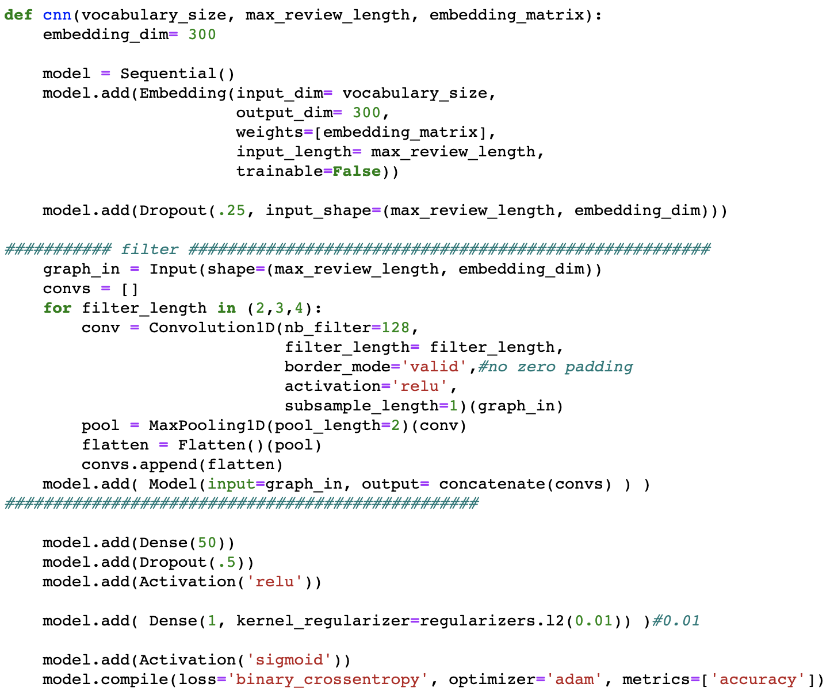
CNN

Slide 11
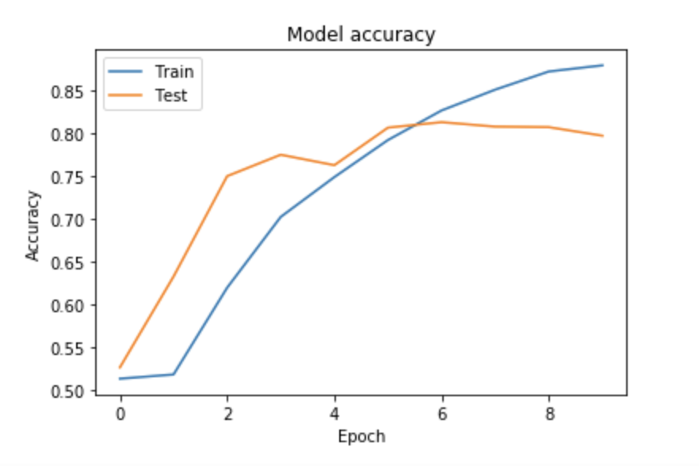
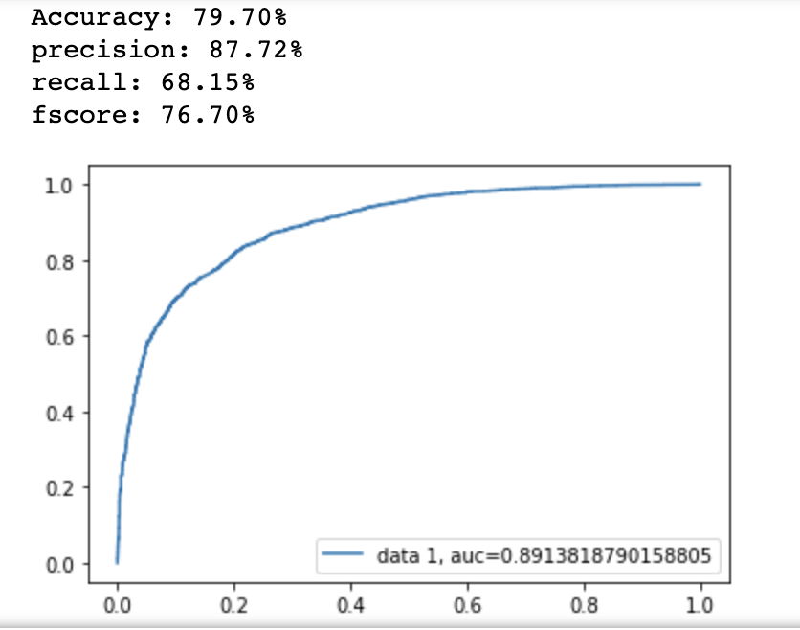
Metrics

Slide 12
LSTM
Defintion………
https://colah.github.io/posts/2015-08-Understanding-LSTMs/

Slide 13
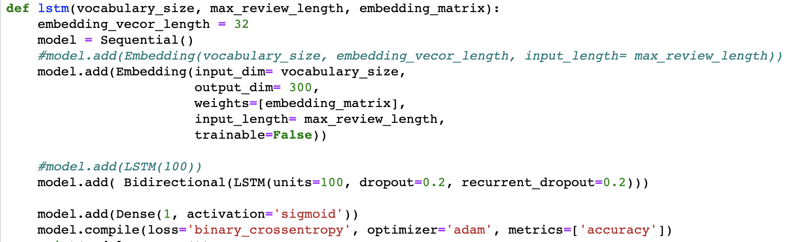
LSTM

Slide 14
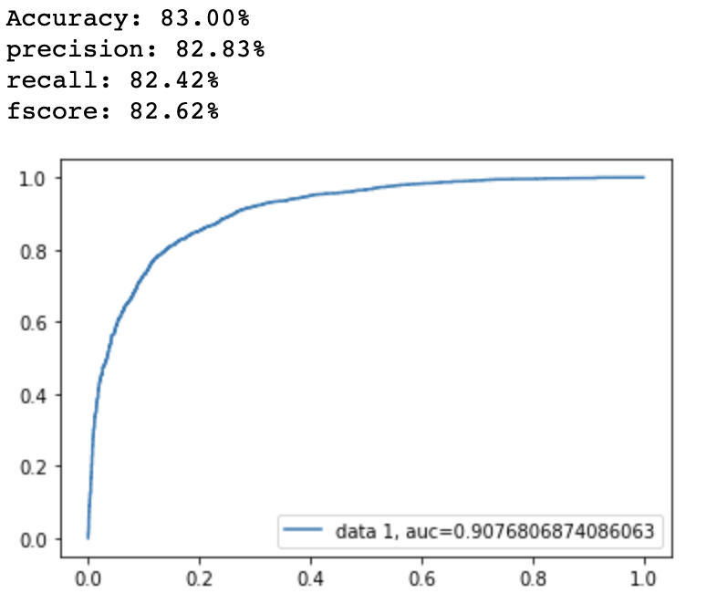
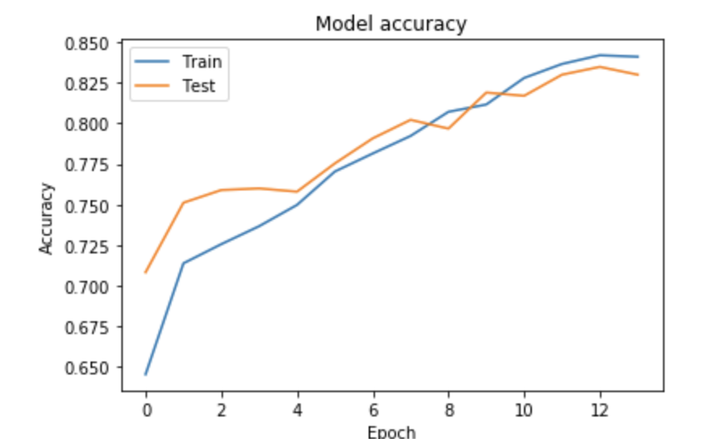
Metrics

Slide 15
Question?

Slide 16
Refrence
[1] Convolutional Neural Networks for Sentence Classification [2] Fine-Grained Sentiment Analysis on Financial Microblogs and News [3] Sentiment Analysis on Financial Data Using Neural Networks [4] Inferring Sentiment towards Brands from Financial News Headlines [5] Hierarchical Attention Networks for Document Classification

